Slide 1
Pengenalan SQL
SQL Statement & Basic Select

Slide 2
Outline
Apa itu SQL?
SQL dalam Pengawasan
SQL Server Management Studio sebagai Tools
SQL Statement
Simple SQL Query

Slide 3
Apa itu SQL?
Structured Query Language (SQL)

Slide 4
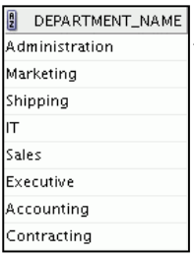
Structured Query Language (SQL)
Merupakan bahasa standar ANSI untuk mengoperasikan basis data relasional
Efisien, mudah dipelajari, dan digunakan
Functionally complete (dengan SQL, kita bisa mendefinisikan, mengambil, dan memanipulasi data dalam table)
SELECT department_name FROM departments;
RDBMS
Server
Notes:
In a relational database, you do not specify the access route to the tables, and you do not need to
know how the data is arranged physically.
To access the database, you execute a structured query language (SQL) statement, which is the
American National Standards Institute (ANSI) standard language for operating relational
databases. SQL is a set of statements with which all programs and users access data in an Relational
Database.

Slide 5
Pekerjaan yang dapat dilakukan dengan SQL
• Melakukan query atas data
• INSERT, UPDATE, DELETE baris data pada tabel
• CREATE, REPLACE, ALTER and DROP objek pada basis data
• Mengendalikan akses ke basis data dan objek didalamnya
• Menjaga kosistensi dan integritas basis data
SELECT department_name FROM departments;
RDBMS
Server
Notes:
SQL provides statements for a variety of tasks, including:
• Querying data
• Inserting, updating, and deleting rows in a table
• Creating, replacing, altering, and dropping objects
• Controlling access to the database and its objects
• Guaranteeing database consistency and integrity
SQL unifies all of the preceding tasks in one consistent language and enables you to work with
data at a logical level

Slide 6

Bagaimana SQL bekerja dalam aplikasi/program
Aplikasi atau program biasanya memungkinkan pengguna mengakses basis data tanpa menggunakan SQL secara langsung
SELECT department_name FROM departments;
RDBMS
Server
Hasil Query
Pengguna
Aplikasi
Notes:
Application programs often allow users access to the database
without using SQL directly, but these applications, in turn, must use SQL when executing the
user’s request.

Slide 7
RDBMS Client dan SQL Statement
Adminstrator basis data/pengembang aplikasi menggunakan client tools untuk menjalankan/mengembangkan SQL statement ke basis data
Via Client Tools
SELECT department_name FROM departments;
RDBMS
Server
Hasil Query
DbAdmin/
Programer
Notes:
Application programs often allow users access to the database
without using SQL directly, but these applications, in turn, must use SQL when executing the
user’s request.

Slide 8




RDBMS Client dan SQL Statement
Perlu dipastikan bahwa client tools yang digunakan kompatibel dengan RDMBS yang akan diakses
RDBMS
Client
SQL Plus
SQL developer
SQL Server Management Studio
MySQL Workbench
PgAdmin
Notes:
Beberapa RDBMS client tools dapat digunakan pada multi RDBMS

Slide 9
SQL dalam Pengawasan
Sebagai RDBMS Client Tools

Slide 10


Bagaimana skema mengaudit dengan SQL?
Auditor mengakses langsung basis data lingkungan pengembangan/staging/data warehouse menggunakan RDBMS client
SELECT department_name FROM departments;
Mengembangkan
script
RDBMS
Server lingkungan pengembangan/staging
Hasil Query
Tampilkan/
ekspor hasil pengujian
Auditor
SQL Client
aplikasi objek audit lingkungan pengembangan

Slide 11
Yang Perlu Diperhatikan Auditor
Mendapatkan informasi berikut:
Jenis RDBMS aplikasi > mempengaruhi RDBMS client yang akan digunakan
IP address server lingkungan pengembangan/staging untuk mengembangkan query SQL pengujian
User dan password yang akan digunakan untuk mengakses
Informasi awal perbedaan server lingkungan pengembangan dengan lingkungan live/production
Jika auditor langsung mengakses ke basis data auditi , perlu dipertimbangkan, hal berikut:
Waktu peak transaksi
Query direviu terlebih dahulu oleh auditi
Hanya query menggunakan SELECT (read only)

Slide 12
Overview SQL Server Management Studio
Sebagai RDBMS Client Tools

Slide 13
SQL Server Management Studio
Tools RDBMS client untuk pengembangan dan administrasi basis data
Digunakan pada lingkungan basis data SQL Server
Banyak digunakan oleh database developer dan admin karena:
Cost-free
Advanced user experience
Various add-in options
Easy installation
Notes:
SQL Server Management Studio, also known as SSMS, is an intuitive and multi-purpose database development and administration tool primarily used by SQL Professionals including SQL database developers, database administrators and infrastructure teams to manage SQL Server environments.

Slide 14
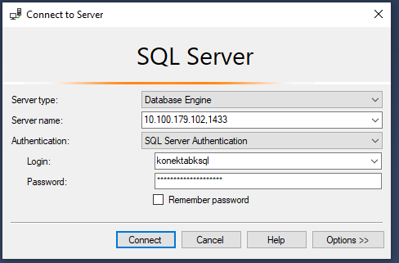
Koneksi ke basis data
Setelah instalasi, untuk terhubung ke basis data klien pengawasan auditor membutuhkan:
IP address basis data auditi
User basis data yang diberikan auditi (beserta password)
IP address basis data auditi
(port opsional)
User basis data beserta password

Slide 15
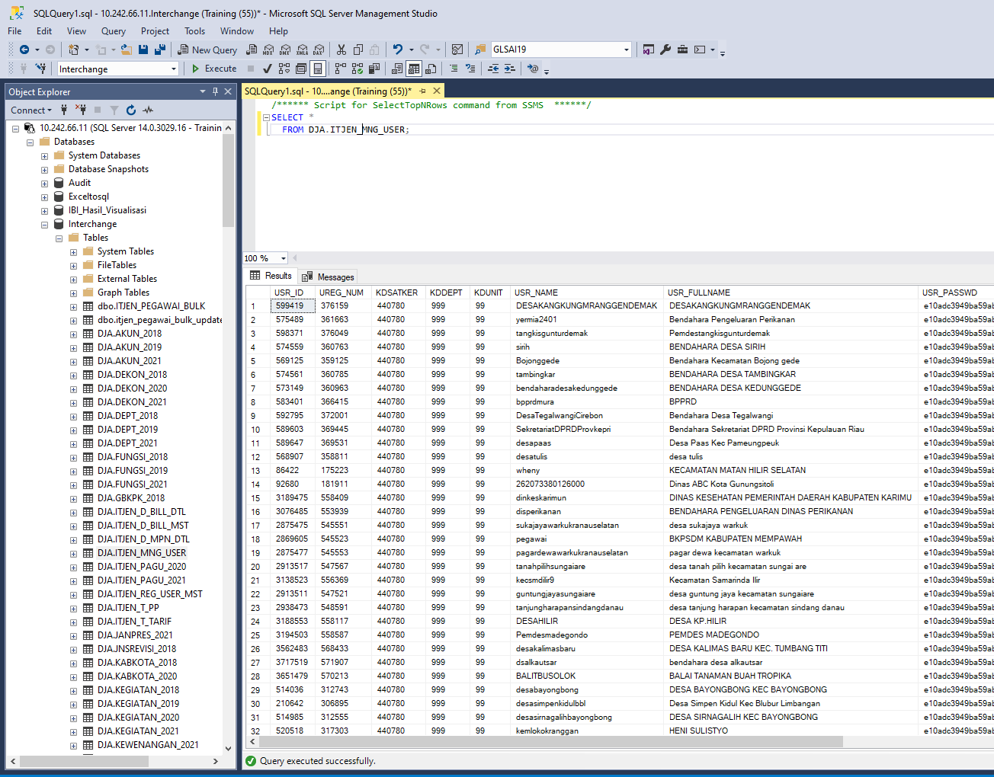
Interface Aplikasi SSMS
Query editor
Basis data yang diakses
Table dalam basis data
Isi table yang aktif (sedang di-query)
Indikator sukses/gagal query
Notes:
Interface Utama Aplikasi SSMS terdiri dari:
Object explorer
Query Editor
Result view

Slide 16
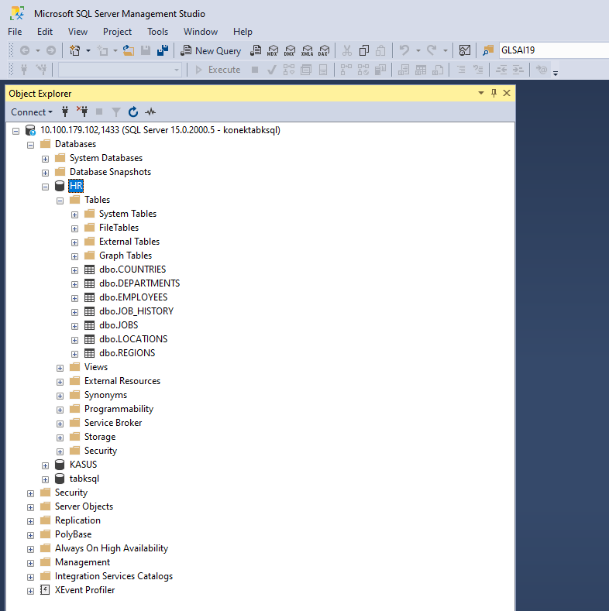
Object Explorer
Menyajikan hirarki objek pada server basis data
Memungkinkan kita untuk:
Mencari objek tertentu
View and edit properties objek
Manajemen objek-objek
Menjalankan custom report
Notes:
Object Explorer is the most frequently used feature in SQL Server Management Studio. Object Explorer has a user interface that offers a convenient hierarchical view of server objects, similar to Windows Explorer with its system of folders, subfolders, files, etc. Among the many helpful options, it allows you to do the following:
Search a specific object
View and edit object properties
Manage objects represented as nodes
Run custom reports

Slide 17
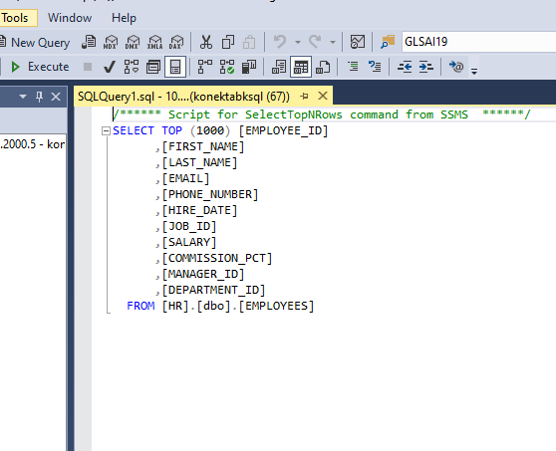
Query Editor
Tombol untuk mengeksekusi query
Untuk menyusun/mengembangkan, mengeksekusi, dan debugging kode SQL
Interface utama yang akan digunakan auditor dalam mengembangkan script pengujian
Untuk menjalankan script yang telah dibuat klik tombol execute di tab menu, atau F5 pada keyboard
Notes:
The primary tasks of SQL Server Management Studio are writing, executing, and debugging T-SQL code. To implement these functions, SSMS provides an advanced SQL Query Editor with IntelliSense support. Equipped with this technology, the tool is able to auto-complete code. This means, as soon as you start writing code, the software suggests variants to finish the row. This helps accelerate the code writing process and make it more accurate. There are many more helpful options in SSMS Query Editor:
Building scripts with T-SQL and XQuery statements
SQLCMD Scripts editor
MDX, DMX, and XML/A editors
Code formatting, including syntax highlighting
Code debugging
Commenting and uncommenting selected lines
Code lines numeration
Drag-and-drop text
Selected code executing
Getting query results as text
Saving results to file
Bookmarks
Integration with Query Execution Plan

Slide 18
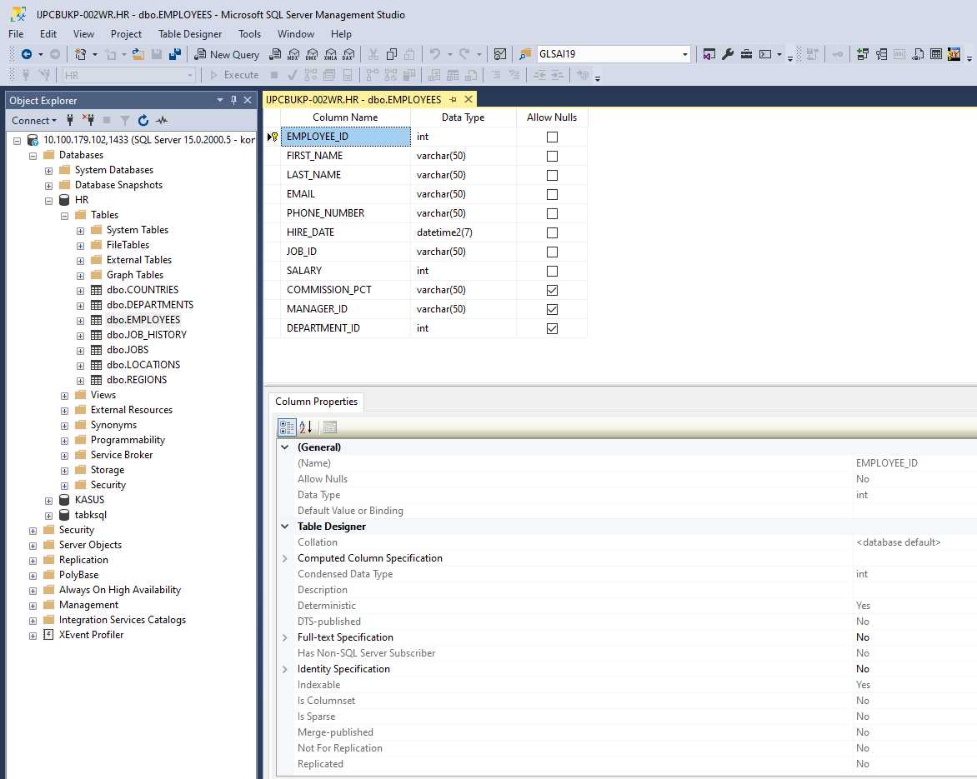
Table Designer
Digunakan untuk mendesain dan visualisasi suatu tabel
Tabel designer memungkinkan user untuk create, edit, delete table maupun komponennya tanpa menggunakan SQL code
Klik kanan suatu table > Design
Notes:
This visual tool lets users design and visualize tables in a database.
Table Designer makes it possible to create, edit, and delete both tables and their components (columns, indexes, keys, relationships, and constraints).
The main advantage is that you can perform all these tasks in a visual mode, without manual typing of SQL code.

Slide 19
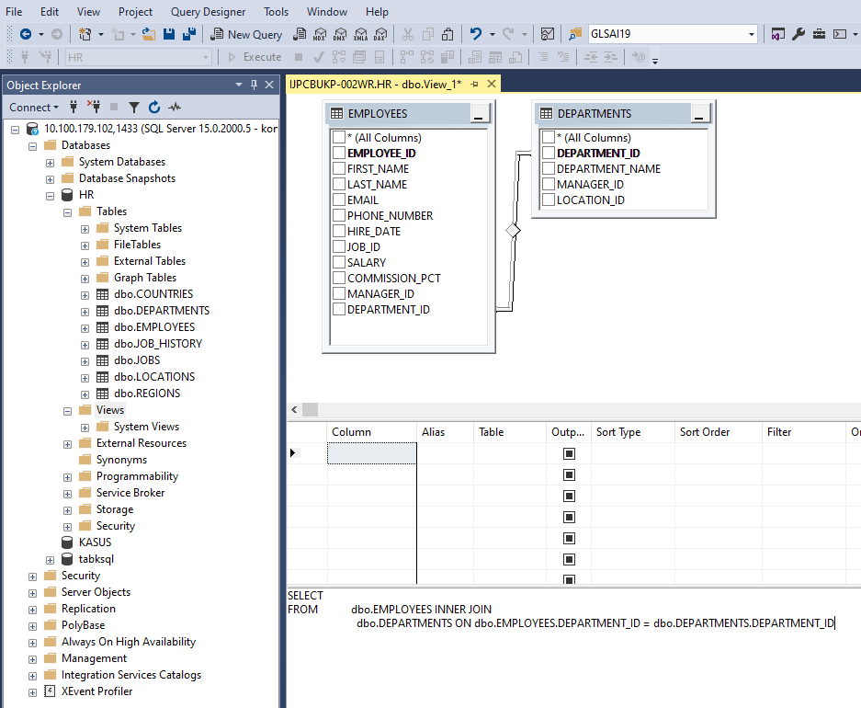
Query Designer
Alat bantu dalam bentuk GUI untuk user dalam mengembangkan script
Dapat diakses menggunakan menu Query > Design ini Query Editor
Notes:
Query and View Designer allows users to develop queries and views.
A significant plus is that you can create database queries using the mouse only – there is no need to write code manually.
The Designer also allows you to select a particular SQL query and create a similar one in the Editor.

Slide 20
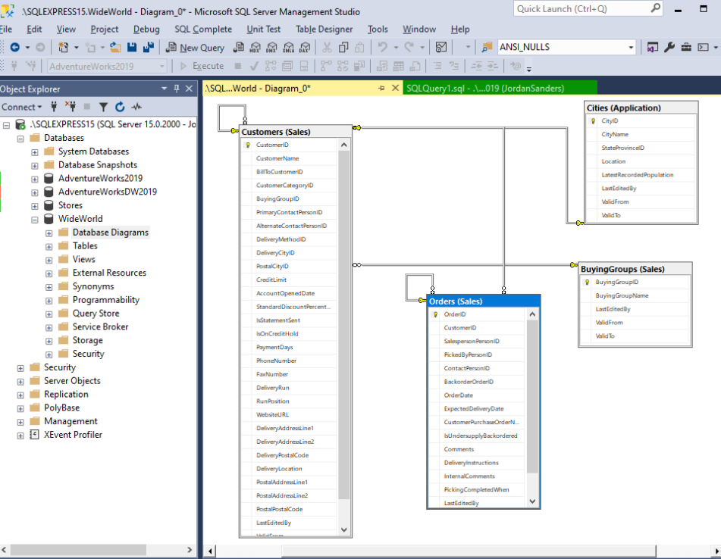
Database Designer
Fitur ini memvisualisasikan tiap hubungan antar tabel dalam suatu basis data tertentu, termasuk komponennya (tables, columns, constraints, and dependencies)
Notes:
Database Designer is another visual tool that assists in designing databases and their components.
It visualizes each database with tables, columns, constraints, and dependencies.
Similarly, you can create and edit databases using diagrams.
With SQL Server Studio, it is possible to work on one or several diagrams – there can be as many of them as necessary.
Also, each database can be a part of multiple diagrams. This way, you can focus on different database aspects.

Slide 21
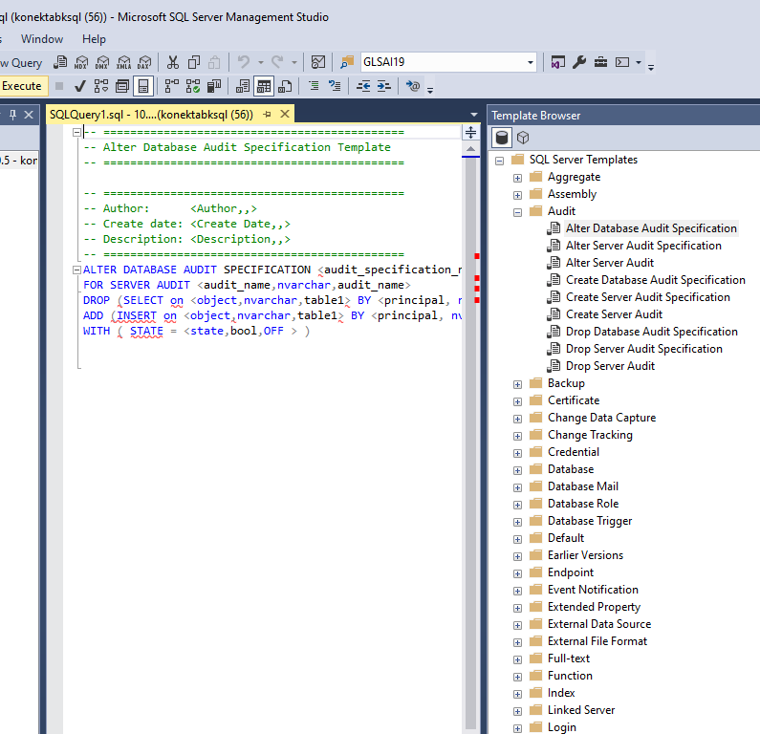
Template Explorer
Template adalah file yang telah berisi script SQL yang ready-made
Dapat diakases melalui View > Template Explorer
Notes:
Templates are files with ready-made SQL scripts that create standard objects (databases, tables, views, indexes, stored procedures, triggers, statistics, and functions). Besides, there are templates for SQL Server Management tasks. You can use them to create extended properties, linked servers, logins, users, roles, and Analysis Services.
There is a large collection of predefined templates available in Template Explorer. Refer to any such file and use the code in the Editor with many customization options. Additionally, you can make custom code templates. All such scripts are organized in folders, so you will have to either take the existing folders or develop a new folder structure.

Slide 22
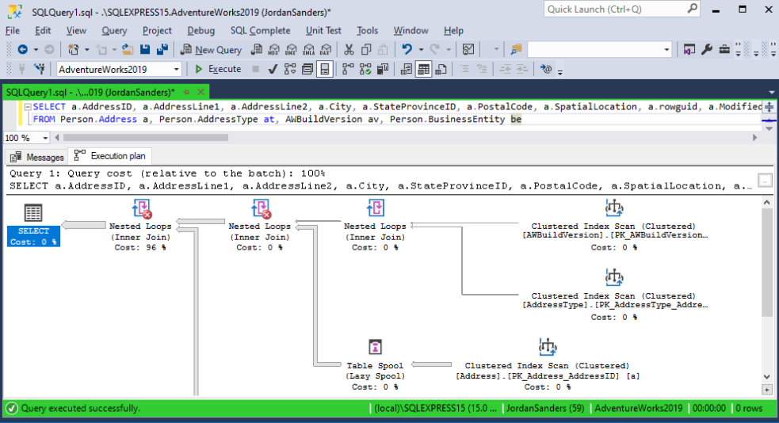
Query Execution Plan
Query execution plan adalah urutan langkan operasi yang dilakukan pada SQL Server untuk menghasilkan query
Untuk mereviu query sebelum dijalankan (terutama yang sensitive dengan resource)
Notes:
A query execution plan is the sequence of operations on SQL Server that you perform to obtain a SQL query result. Before the server executes a SQL query, it must analyze the instructions and define the most efficient way of execution. For that, it uses the Query Optimizer component. Its input data is the query execution plan itself.
In SQL Server Management Studio, you can view a query execution plan and identify the most resource-intensive operations. Then, you can adjust the query to achieve optimal results.

Slide 23
SQL Statement
Overview macam-macam statement

Slide 24
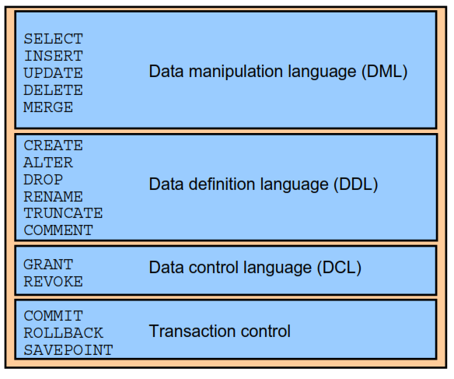
SQL statement

Slide 25
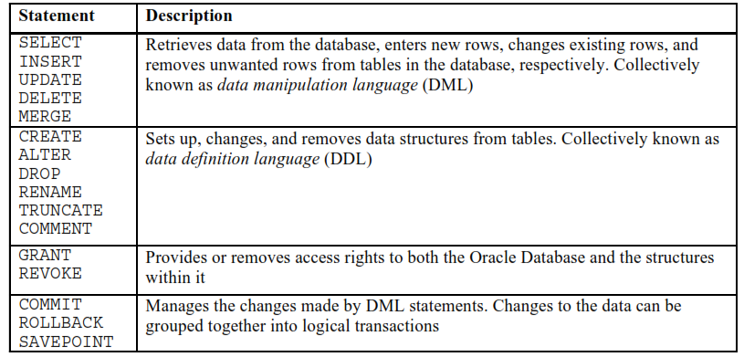
SQL statement

Slide 26
Tipe Data
https://www.w3schools.com/sql/sql_datatypes.asp
String
char(n)
varchar(n)
nvarchar(max)
blob
Numeric
boolean
Int, bigint
bit
float(n)
Date and Time Data Types
Datetime
Timestamp
Date
time
Other Data Types
sql_variant
xml
uniqueidentifier

Slide 27
Writing SQL Statements
SQL statements are not case-sensitive.
SQL statements can be entered on one or more lines.
Keywords cannot be abbreviated or split across lines.
Clauses are usually placed on separate lines.
Indents are used to enhance readability.
In SQL Developer, SQL statements can optionally be terminated by a semicolon (;). Semicolons are required when you execute multiple SQL statements.
Notes:
Writing SQL Statements
By using the following simple rules and guidelines, you can construct valid statements that are both easy to read and edit:
SQL statements are not case-sensitive (unless indicated).
SQL statements can be entered on one or many lines.
Keywords cannot be split across lines or abbreviated.
Clauses are usually placed on separate lines for readability and ease of editing.
Indents should be used to make code more readable.
Keywords typically are entered in uppercase; all other words, such as table names and columns names are entered in lowercase.
Executing SQL Statements
In SQL Developer, click the Run Script icon or press [F5] to run the command or commands in the SQL Worksheet. You can also click the Execute Statement icon or press [F9] to run a SQL statement in the SQL Worksheet. The Execute Statement icon executes the statement at the mouse pointer in the Enter SQL Statement box while the Run Script icon executes all the statements in the Enter SQL Statement box. The Execute Statement icon displays the output of the query on the Results tabbed page while the Run Script icon emulates the SQL*Plus display and shows the output on the Script Output tabbed page.
In SQL*Plus, terminate the SQL statement with a semicolon, and then press [Enter] to run the command.

Slide 28
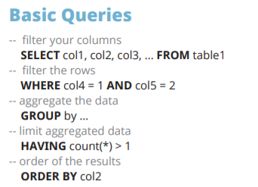
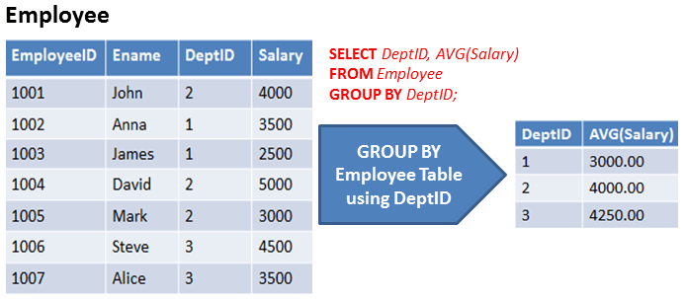

Slide 29
Simple Select SQL Statement
Pengenalan Query

Slide 30
Anatomi SELECT Statement
SELECT EMPLOYEE_ID, FIRST_NAME, HIRE_DATE, JOB_ID, SALARY
FROM EMPLOYEES
WHERE SALARY > 10000;
Clause
Search Condition
Statement

Slide 31
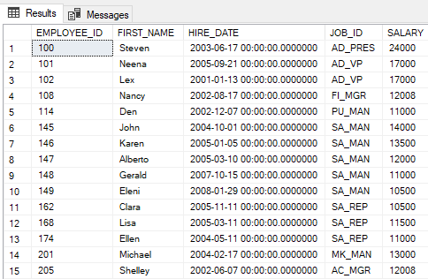
Anatomi SELECT Statement – Fungsi/Kegunaan
Kolom/field yang akan ditampilkan
SELECT EMPLOYEE_ID, FIRST_NAME, HIRE_DATE, JOB_ID, SALARY
FROM EMPLOYEES
WHERE SALARY > 10000;
Tabel yang digunakan
Row yang akan diambil adalah row dengan gaji di atas 10.000
(kriteria audit)

Slide 32
Basic SELECT Statement
SELECT *|{[DISTINCT] column|expression [alias],...}
FROM table;
SELECT identifies the columns to be displayed.
FROM identifies the table containing those columns.
Notes:
Basic SELECT Statement
In its simplest form, a SELECT statement must include the following:
A SELECT clause, which specifies the columns to be displayed
A FROM clause, which identifies the table containing the columns that are listed in the SELECT clause
In the syntax:
SELECT is a list of one or more columns
* selects all columns
DISTINCT suppresses duplicates
column|expression selects the named column or the expression
alias gives the selected columns different headings
FROM table specifies the table containing the columns
Note: Throughout this course, the words keyword, clause, and statement are used as follows:
A keyword refers to an individual SQL element. For example, SELECT and FROM are keywords.
A clause is a part of a SQL statement. For example, SELECT employee_id, last_name, and so on is a clause.
A statement is a combination of two or more clauses. For example, SELECT * FROM employees is a SQL statement.

Slide 33
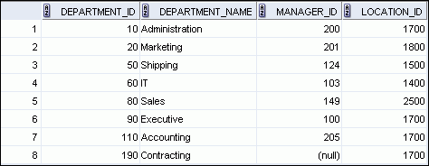
Selecting All Columns
SELECT *
FROM departments;
Notes:
Selecting All Columns
You can display all columns of data in a table by following the SELECT keyword with an asterisk (*). In the example in the slide, the department table contains four columns: DEPARTMENT_ID, DEPARTMENT_NAME, MANAGER_ID, and LOCATION_ID. The table contains eight rows, one for each department.
You can also display all columns in the table by listing all the columns after the SELECT keyword. For example, the following SQL statement (like the example in the slide) displays all columns and all rows of the DEPARTMENTS table:
SELECT department_id, department_name, manager_id, location_id FROM departments;
Note: In SQL Developer, you can enter your SQL statement in a SQL Worksheet and click the “Execute Statement” icon or press [F9] to execute the statement. The output displayed in the Results tabbed page appears as shown in the slide.

Slide 34
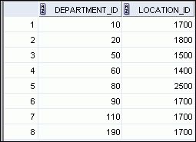
Selecting Specific Columns
SELECT department_id, location_id
FROM departments;
Notes:
Selecting Specific Columns
You can use the SELECT statement to display specific columns of the table by specifying the column names, separated by commas. The example in the slide displays all the department numbers and location numbers from the DEPARTMENTS table.
In the SELECT clause, specify the columns that you want in the order in which you want them to appear in the output. For example, to display location before department number (from left to right), you use the following statement:
SELECT location_id, department_id
FROM departments;
…

Slide 35
Arithmetic Expressions
Create expressions with number and date data by using arithmetic operators.
Operator
Description
+
Add
-
Subtract
*
Multiply
/
Divide
Notes:
Arithmetic Expressions
You may need to modify the way in which data is displayed, or you may want to perform calculations, or look at what-if scenarios. All these are possible using arithmetic expressions. An arithmetic expression can contain column names, constant numeric values, and the arithmetic operators.
Arithmetic Operators
The slide lists the arithmetic operators that are available in SQL. You can use arithmetic operators in any clause of a SQL statement (except the FROM clause).
Note: With the DATE and TIMESTAMP data types, you can use the addition and subtraction operators only.

Slide 36
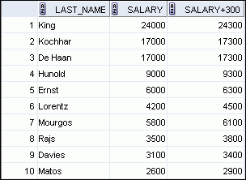
Using Arithmetic Operators
SELECT last_name, salary, salary + 300
FROM employees;
…
Notes:
Using Arithmetic Operators
The example in the slide uses the addition operator to calculate a salary increase of $300 for all employees. The slide also displays a SALARY+300 column in the output.
Note that the resultant calculated column, SALARY+300, is not a new column in the EMPLOYEES table; it is for display only. By default, the name of a new column comes from the calculation that generated it—in this case, salary+300.
Note: The Oracle server ignores blank spaces before and after the arithmetic operator.
Operator Precedence
If an arithmetic expression contains more than one operator, multiplication and division are evaluated first. If operators in an expression are of the same priority, then evaluation is done from left to right.
You can use parentheses to force the expression that is enclosed by the parentheses to be evaluated first.
Rules of Precedence:
Multiplication and division occur before addition and subtraction.
Operators of the same priority are evaluated from left to right.
Parentheses are used to override the default precedence or to clarify the statement.

Slide 37


Operator Precedence
SELECT last_name, salary, 12*salary+100
FROM employees;
1
…
SELECT last_name, salary, 12*(salary+100)
FROM employees;
2
…
Notes:
Operator Precedence (continued)
The first example in the slide displays the last name, salary, and annual compensation of employees. It calculates the annual compensation by multiplying the monthly salary with 12, plus a one-time bonus of $100. Note that multiplication is performed before addition.
Note: Use parentheses to reinforce the standard order of precedence and to improve clarity. For example, the expression in the slide can be written as (12*salary)+100 with no change in the result.
Using Parentheses
You can override the rules of precedence by using parentheses to specify the desired order in which the operators are to be executed.
The second example in the slide displays the last name, salary, and annual compensation of employees. It calculates the annual compensation as follows: adding a monthly bonus of $100 to the monthly salary, and then multiplying that subtotal with 12. Because of the parentheses, addition takes priority over multiplication.

Slide 38
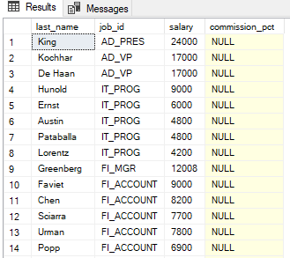
Null Value
SELECT last_name, job_id, salary, commission_pct
FROM employees;
Notes:
If a row lacks a data value for a particular column, that value is said to be null or to contain a null.
Null is a value that is unavailable, unassigned, unknown, or inapplicable. Null is not the same as zero or a blank space. Zero is a number and blank space is a character.
Columns of any data type can contain nulls. However, some constraints (NOT NULL and PRIMARY KEY) prevent nulls from being used in the column.
In the COMMISSION_PCT column in the EMPLOYEES table, notice that only a sales manager or sales representative can earn a commission. Other employees are not entitled to earn commissions. A null represents that fact.

Slide 39
Column Alias
Renames a column heading
Is useful with calculations
Immediately follows the column name (There can also be the optional AS keyword between the column name and the alias.)
Requires double quotation marks if it contains spaces or special characters, or if it is case-sensitive
Notes:
When displaying the result of a query, SQL Developer normally uses the name of the selected column as the column heading. This heading may not be descriptive and, therefore, may be difficult to understand. You can change a column heading by using a column alias.Specify the alias after the column in the SELECT list using blank space as a separator. By default, alias headings appear in uppercase. If the alias contains spaces or special characters (such as # or $), or if it is case-sensitive, enclose the alias in double quotation marks ("").

Slide 40
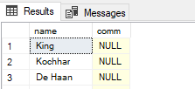
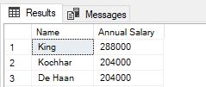
Column Alias
SELECT last_name AS name, commission_pct comm
FROM employees;
1
…
SELECT last_name "Name" , salary*12 "Annual Salary"
FROM employees;
2
…
Notes:
The first example displays the names and the commission percentages of all the employees. Note that the optional AS keyword has been used before the column alias name. The result of the query is the same whether the AS keyword is used or not. Also, note that the SQL statement has the column aliases, name and comm, in lowercase, whereas the result of the query displays the column headings in uppercase. As mentioned in the preceding slide, column headings appear in uppercase by default.
The second example displays the last names and annual salaries of all the employees. Because Annual Salary contains a space, it has been enclosed in double quotation marks. Note that the column heading in the output is exactly the same as the column alias.

Slide 41
Select Distinct
Renames a column heading
Is useful with calculations
Immediately follows the column name (There can also be the optional AS keyword between the column name and the alias.)
Requires double quotation marks if it contains spaces or special characters, or if it is case-sensitive
Notes:
When displaying the result of a query, SQL Developer normally uses the name of the selected column as the column heading. This heading may not be descriptive and, therefore, may be difficult to understand. You can change a column heading by using a column alias.Specify the alias after the column in the SELECT list using blank space as a separator. By default, alias headings appear in uppercase. If the alias contains spaces or special characters (such as # or $), or if it is case-sensitive, enclose the alias in double quotation marks ("").

Slide 42
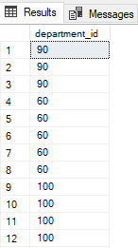
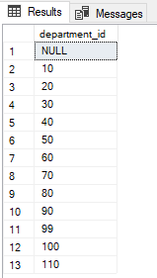
Select Distinct – Duplicate row
SELECT department_id
FROM employees;
SELECT DISTINCT department_id
FROM employees;
1
2
…
…
Notes:
The first example displays the names and the commission percentages of all the employees. Note that the optional AS keyword has been used before the column alias name. The result of the query is the same whether the AS keyword is used or not. Also, note that the SQL statement has the column aliases, name and comm, in lowercase, whereas the result of the query displays the column headings in uppercase. As mentioned in the preceding slide, column headings appear in uppercase by default.
The second example displays the last names and annual salaries of all the employees. Because Annual Salary contains a space, it has been enclosed in double quotation marks. Note that the column heading in the output is exactly the same as the column alias.

